Slide 1


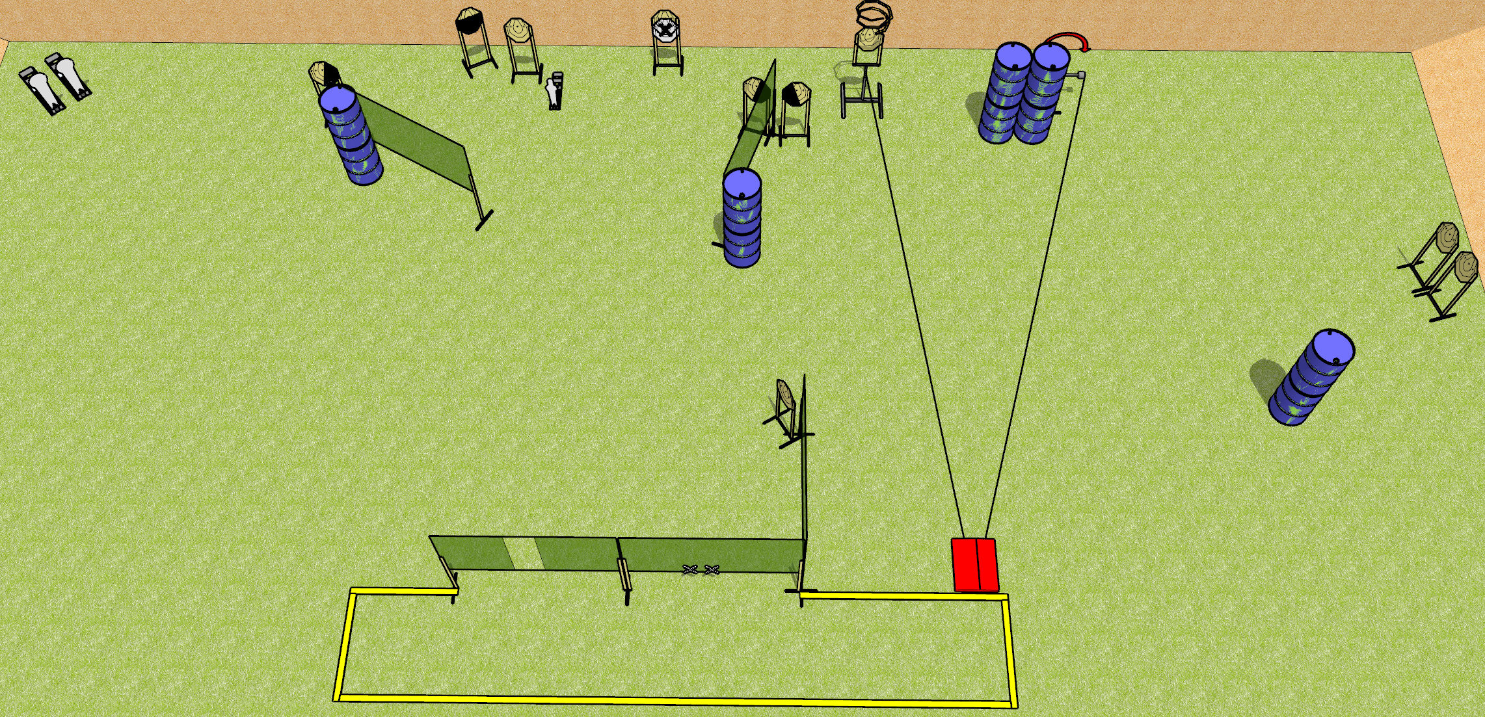
 | Dothan Gun Club – USPSA Match Stomping Grounds Course Designer : Drew Coleman
Round Count 25 rounds 11 IPSC 2 colt, 1 mini
Equipment List 8 wall feet 3 medium fault lines Stomp box + swinger + turner 1 left + 2 right diag, 1 50%

Slide 2
Stomping Grounds
Written Stage Briefing
Stomping Grounds is a 25 round, 125 point, Comstock course of fire. There are 11 IPSC targets, 2 colt poppers, and 1 mini popper. The best 2 hits on paper will score and steel must fall to score. The start signal is audible.
The turner and swinger are both activated by the stomp box. The turner is a disappearing target and the swinger remains visible at rest. The stomp box is NOT part of the shooting area.
Handgun start position is both hands touching marks. Handgun is loaded and holstered.
PCC start position is muzzle touching either mark, stock on belt. Loaded carbine is held with both hands, safety on.
On start signal, engage targets as they become available from within the shooting area.

